Slide 1
Virtual Keyboard Architecture and Qt Applications

Slide 2
Input Method API in Qt
Input Method API.
Virtual Keyboards in Qt.
Use Qt input method API in Qt applications.

Slide 3
Input Method API in Qt
QInputMethod:
Access virtual keyboard from application.
QPlatformInputContext:
Logic component, return combined text, transform text...
QInputMethodQueryEvent:
Send information from application to virtual keyboard .
QInputMethodEvent/ QKeyEvent:
Send input events from virtual keyboard to application.

Slide 4
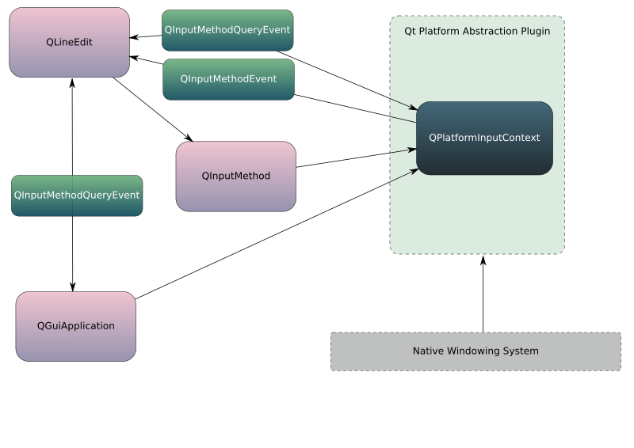
Input Method API in Qt

Slide 5
QPlatformInputContext (logic)
QPlatformInputContext provides an interface the actual input methods can derive from by reimplementing methods.
An input method is responsible for inputting complex text that cannot be inputted via simple map. It converts a sequence of input events (typically key events) into a text string through the input method specific converting process.
Perform grammar and semantic analysis.

Slide 6
QPlatformInputContext
Two kinds of QPlatformInputContext for virual keyboard:
Native provided by platform: Android, IOS, Windows…
Custom via QPlatformInputContextFactory.

Slide 7
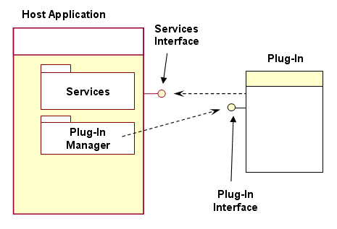
Plug-in Architecture

Slide 8
Plug-in Architecture
A plug-in is a piece of software that extends or changes the behavior or interface of an existing, compiled application:
QPlatformInputContextPlugin = Plug-in Manager.
QPlatformInputContext = Plug-in.
Focus Object = Service Interfaces.

Slide 9
QPlatformInputContextFactory
Là plug-in manager, được định nghĩa thông qua QT_IM_MODULE. Lớp tạo ra các QPlatformInputContext tương ứng.
Các nền tảng hỗ trợ:
Eglfs
Directfb
Xcb
Cocoa
Mirclient
Wayland
Windows

Slide 10
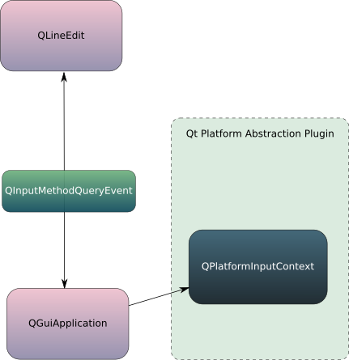
QPlatformInputContextFactory

Slide 11
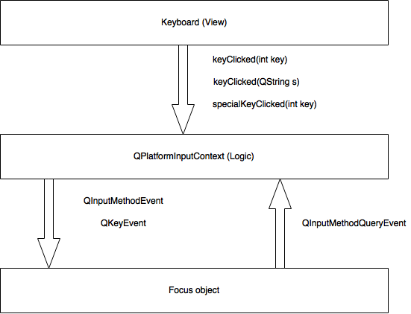
Input Method

Slide 12
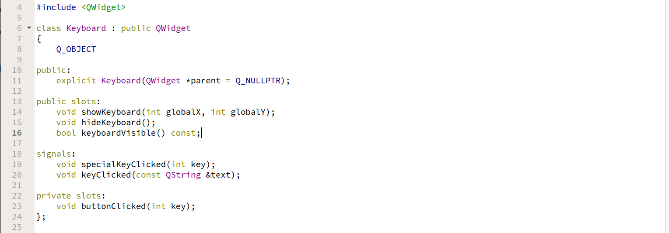
Keyboard (View)

Slide 13
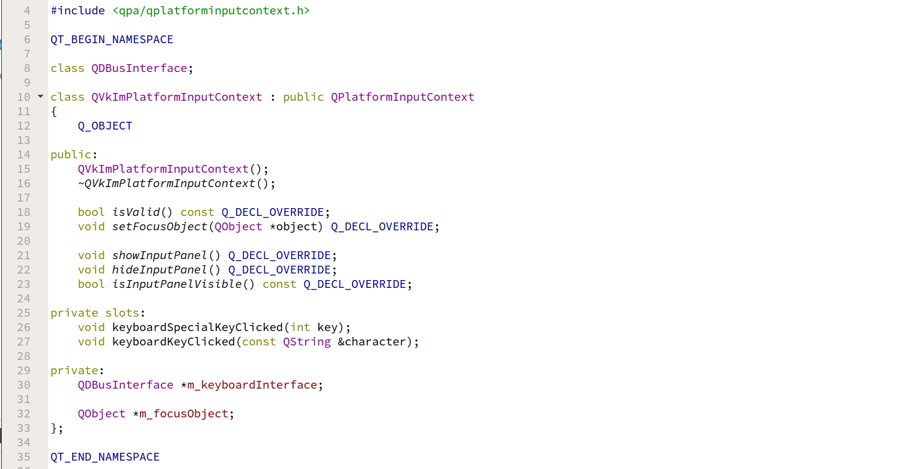
QPlatformInputContext (Logic)

Slide 14
QInputMethodEvent/ QKeyEvent
QKeyEvent: sent to the widget with keyboard input focus when keys are pressed or released.
QInputMethodEvent: sent to widgets when an input method is used to enter text into a widget. Input methods are widely used to enter text for languages with non-Latin alphabets.

Slide 15
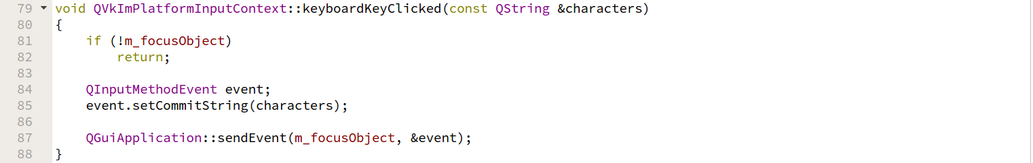
QInputMethodEvent

Slide 16
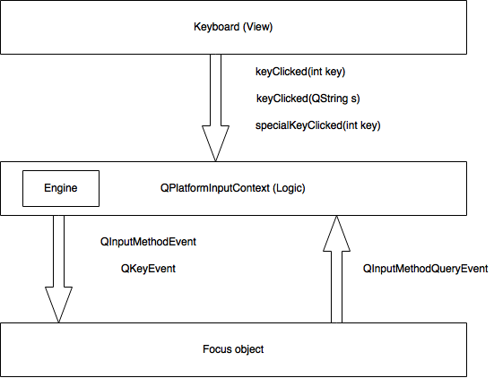
Vietnamese Input Method

Slide 17
Engine
Là khối xử lý các thuật toán gõ tiếng Việt.
Common Vietnamese input methods
Telex
VNI
VIQR

Slide 18
Available virtual keyboard for Qt
Multi language support.
Support for text correct.

